Slide 1
Image Shadow Removal Using Non-Shadow Mapping
A CSE-4019 (Image Processing) Project

Slide 2
Team Members
Karmabir Chakraborty (19BCE1439)
Sarthak Tyagi (19BCE1666)
Venkata Ashish Nunna (19BCE1256)
Aryan Arora (19BCE1479)

Slide 3
Abstract
Gathering information from images has become an important aspect of technology and its advancement. Henceforth, we extract a lot of sensitive information from images that can be further used as evidence or to infer some really important research result.
In some situations, shadows darken the area of concern eliminating the correct result and raising a possibility of a wrong inference. Therefore, we need a shadowless image for processing results. Shadow removal has evolved as a pre-processing step for various computer vision tasks.
Our method considers the shadow part of the image and finds it’s non shadow counterpart. It uses non shadow mapping to lighten the shadow regions with the help of histogram matching.
It also preserves the texture of the image to much extent by considering gradient and texture features. Our method is evaluated on three metrics in order to analyse its accuracy.

Slide 4
Objective
To identify the shadow regions
To find the non-shadow mapping of the shadow pixel
To manipulate the shadow pixel according to its non-shadow mapping for an effective shadow removal
To preserve the texture of the image

Slide 5
Introduction
Shadows have their own limitations and advantages. But they may pose a problem in various computer vision algorithms like edge extraction, object identification, object counting, and image matching
Shadows can be classified into soft and hard shadows and when generated by the interruption of a non-point illumination source have two distinct regions namely, umbra and penumbra
Although shadows can provide useful cues for estimating scene illumination, finding the geometry of object casting the shadow, locating the light source and so on, their presence may cause hindrance in various image and video processing tasks, such as segmentation, object detection, and video surveillance
Therefore, the removal of shadows is inevitable for the flawless execution of these algorithms.

Slide 6
Properties of Shadows
It is observed that shadow regions have lower values for RGB, grey level intensity, standard deviation, variance, local maximum, and brightness since these values depend on the illumination and the shadow regions are less illuminated than the surroundings
The hue value that indicates the dominant colour of a surface remains nearly the same in both shadow and shadowless regions
Difference in skewness values arises due to differences in the asymmetries in shadow and non-shadow regions
Since shadow areas are darker, their entropy and saturation values are less

Slide 7
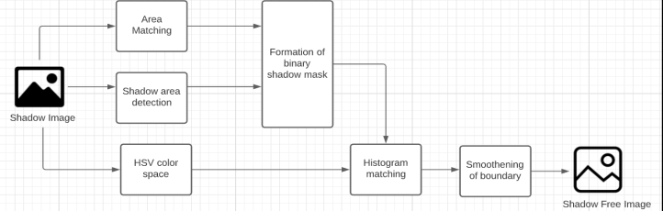
Proposed Work
First step: Image segmentation using mean shift clustering
Next, the whole shadow detection and removal procedure is divided into three major categories: 1) Area matching for texture preservation. 2) Shadow pixel detection. 3) Mapping shadow pixel to non-shadow similar pixel for shadow removal.

Slide 8
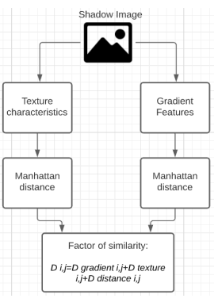
Area Matching for Texture Preservation
The area matching algorithm first segments the image and then helps in recognizing the nearest most 11 similar segment and degree of similarity of a particular segment with respect to the other segments present in the image
This will help in getting the information of the neighbouring pixel which can help in reducing the chances of misclassification of the pixels as shadow or non-shadow pixel

Slide 9
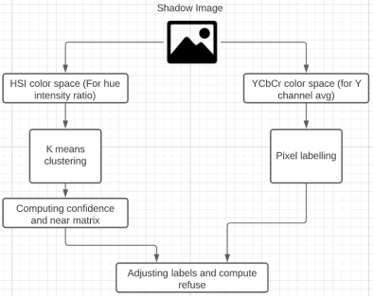
Shadow area detection
First the conversion of image into YCbCr plane and HSI plane takes place for labelling the pixels as shadow pixels, and calculating near and between matrices for feature restoration according to the similar regions
A refuse matrix is also calculated to restrict the non-shadowed regions. A shadow mask is generated after labelling the pixels.
The removal part also takes the original image and converts it into HSV colour space.
Each channel of the HSV image is individually processed and, in each processing, histogram matching takes place between the original image and the template formed in the detection part.

Slide 10
Mapping Shadow Pixel to Non-Shadow Similar Pixel
The basic idea of shadow removal is to find non shadow mapping for the shadow pixel and change accordingly. In the end, the image channels are recombined and converted into RGB colour space.
The shadow boundaries are smoothened by applying the gaussian filter and then taking the intersection of the output image and blur image.
All the three channels of HSV colour space are adjusted using this histogram matching
All the three channels are then merged again and converted into RGB colour space. The boundary of the shadow is smoothed to give an even texture to the whole image.
For this, first 15 the gaussian filter is applied to the RGB image to get the smooth pattern of the image. Then the intersection boundary of shadow and non-shadow areas is calculated and then the pattern is used to smoothen the boundary pixels.

Slide 11
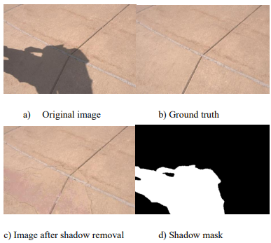
Results
The successful working of the proposed shadow removal algorithm has been implemented and has been tested with various images to prove its efficiency.
The detection aspect can ensure the consistency of the image to a certain extent through mutual restriction of the same area of the image

Slide 12
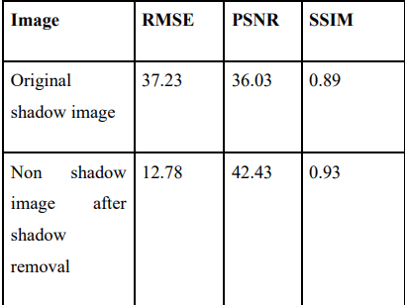
Quantitative Analysis

Slide 13
Conclusion
Shadows may lead to the incorrect execution of certain tasks in computer vision, such as object detection and counting. They are also a challenge in the digital forensic field as they can be used for data hiding.
To tackle this challenge, we proposed a method which involved three color spaces to remove shadows from an image. The texture of the image is preserved to much extent by considering the gradient and the texture features with the help of extensive methods from. Our method is based on MATLAB and does not require prior training on the dataset.
It works on both hard shadows and soft shadows with texture.
Moreover, it also smoothened the boundary after removing the shadow from the original image to make the image look more even. But if there is a dark object covered entirely by the shadow, sometimes it is considered as the shadow and it gives the wrong result.
Overall, this method works for shadow images with two or three textures and it reduces the overall RMSE of the image

Slide 14
Limitations
It works for shadows images having two or three different textures.
It doesn’t work for rigid surfaces because it fails to get the whole shadow into account.
It cannot fully remove the shadow border and uses a gaussian filter for smoothening which affects the PSNR value of the image.
It doesn't give a proper result for an image with many color classes.

